Slide 1
Topic: Measurement
EQ – How do I calculate the surface area of cubes and other prisms?
Get your VIVO’s
Topic and EQ in Interactive Notebook
Don’t forget your mathspace homework
Have a go: Find the area of the following
6m
120mm
110mm
4m
9cm
100mm
50mm
4cm

Slide 2
Lesson objective
By the end of this lesson you will be able to
- calculate the surface area of a cubes and other prisms
1. Handout a copy of this PPT presentation
2. YOU CHOOSE TO use this POWERPOINT and/or WATCH:
https://www.youtube.com/watch?v=daJFLVAQrRA
3. Work through Mathspace task: Classwork T1 W3_ Lesson 1 Surface Area
Notes:
Lesson

Slide 3
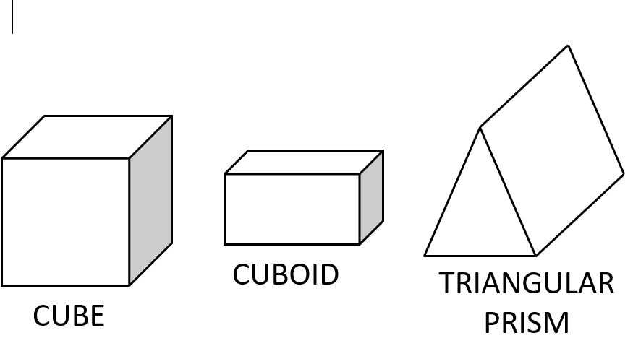
24
7
30
Date
Measurement
EQ – How do I calculate the surface area of cubes and other prisms?
A prism is a 3D shape that has a constant cross-section.
What is a prism?
5
Notes:
Input

Slide 4
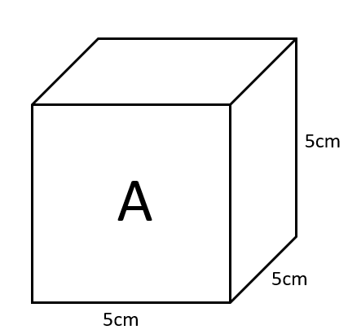
24
7
30
Date
Measurement
EQ – How do I calculate the surface area of cubes and other prisms?
How do I find the surface area of a cube?
Each face is the same – a square.
Area A = 5 x 5
= 25cm²
Total Surface Area = 6 x 25
= 150cm²
Surface area is the total area of the outside of a 3D object
5
Notes:
Input

Slide 5
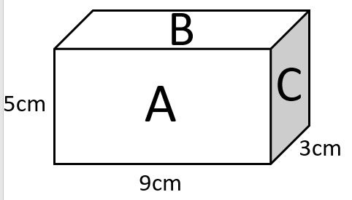
24
7
30
Date
Measurement
EQ – How do I calculate the surface area of cubes and other prisms?
How do I find the surface area of a rectangular prism (cuboid)?
Area A = 5 x 9
= 45cm²
Area B = 9 x 3
= 27cm²
Area C = 3 x 5
= 15cm²
Total Surface Area = (45 + 27 + 15) x 2 = 174cm²
5
Notes:
Input

Slide 6
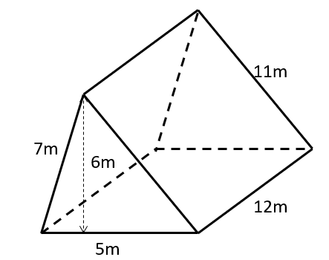
24
7
30
Date
Measurement
EQ – How do I calculate the surface area of cubes and other prisms?
How do I find the surface area of a triangular prism
Area of Triangles = ½ x 5 x 6
= 15m²
= 15 x 2
= 30m²
Area of Rectangle 1 = 12 x 11
= 132m²
Area of Rectangle 2 = 5 x 12
= 60m²
Area of Rectangle 3 = 12 x 7
= 84m²
Total Surface Area = 30 + 132 + 60 + 84
= 306m²
5
Notes:
Input

Slide 7
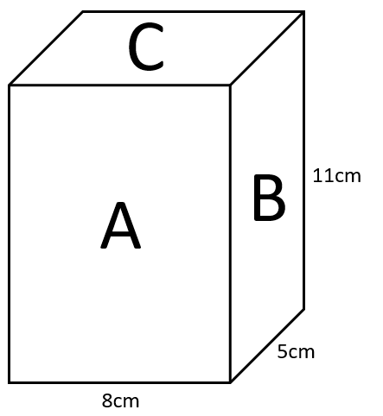
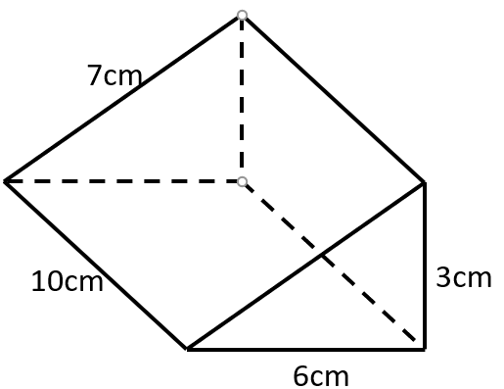
Guided practice- Find the surface area of the following 3D shapes
Area A = 8 x 11
= 88cm²
Area B = 5 x 11
= 55cm²
Area C = 5 x 8
= 40cm²
TOTAL SURFACE AREA
= (88 + 55 + 40) x 2
= 183 x 2
= 366cm²
Area of Triangles = ½ x 3 x 6
= 9m²
= 9 x 2
= 18m²
Area of Rectangle 1 = 10 x 6
= 60m²
Area of Rectangle 2 = 7 x 10
= 70m²
Area of Rectangle 3 = 3 x 10
= 30m²
Total Surface Area = 18+ 60 + 70 + 30
= 178m²

Slide 8
Surface Area of Prisms
Area of Parallelograms
= 9 x 7
= 63cm²
Area of Rectangles 1
= 11 x 9
= 99cm²
99 x 2
= 198cm²
Area of Rectangles 2
= 8 x 11
= 88cm²
88 x 2
= 176cm²
TOTAL SURFACE AREA
= 63 + 198 + 176
= 437cm²
7cm
8cm
11cm
9cm

Slide 9
Surface Area of Prisms
6cm
TOTAL SURFACE AREA = 56 + 128 + 160 + 128 + 96
= 568cm²
8cm
7cm
8cm
16cm
Area of Trapeziums = ½ (10 + 6) x 7
= ½ x 16 x 7
= 56cm²
10cm
Area of Rectangle 1 = 16 x 8
= 128cm²
Area of Rectangle 2 = 10 x 16
= 160cm²
Area of Rectangle 3 = 16 x 8
= 128cm²
Area of Rectangle 4 = 6 x 16
= 96cm²

Slide 10
Activity 1 Surface Area
Calculate the Surface Area of the cube and cuboids shown below:
SA = 294cm²
SA = 378cm²
15cm
7cm
3cm
EXTENSION:
8cm
SA = 270cm²
9cm
6cm
12cm
5cm

Slide 11
Activity 2 Surface Area
Calculate the surface area of the following shapes.
5cm
9cm
14m
3cm
6cm
4cm
1m
2m

Slide 12
Find the surface area of the following shapes
6m
4cm
5m
4m
3cm
7cm
9m
5m
7cm
8cm
11cm
9cm

Slide 13
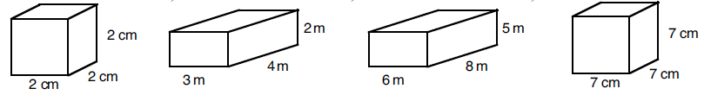
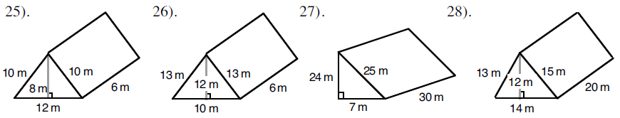
1.
2.
4.
3.
5.
6.
7.
8.
9. Katy wants to wrap a present that is 15cm wide, 18cm deep and 4cm high. How much wrapping paper will she need to use?
10. A length of copper piping is in the shape of a triangular prism. The triangle on it’s end is 9mm tall, 4mm wide. The piece of pipe is 18cm long. What is the surface area of the pipe?
11. A box has no lid. The box measures 1.2m by 30cm by 45cm. What is the surface area of the outside of the box?

